Slide 1
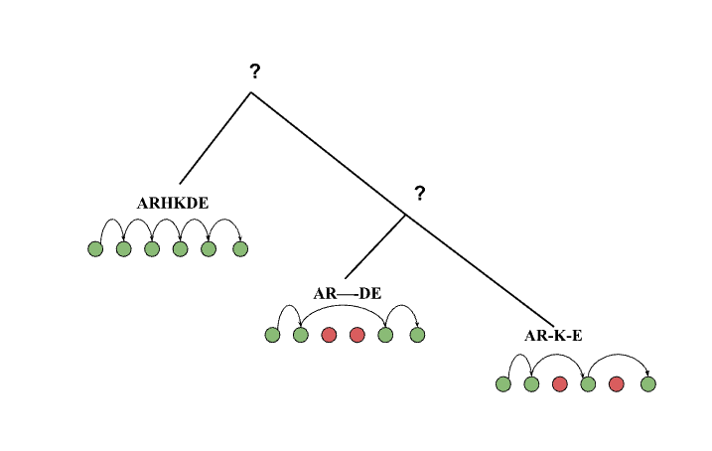

Optimal Phylogenetic Reconstruction of Insertion and Deletion Events.
Sanjana Tule, Gabriel Foley, Chongting Zhao, Michael Forbes, Mikael Bode’n School of Chemistry and Molecular Biosciences, The University of Queensland
Boden Lab

Slide 2


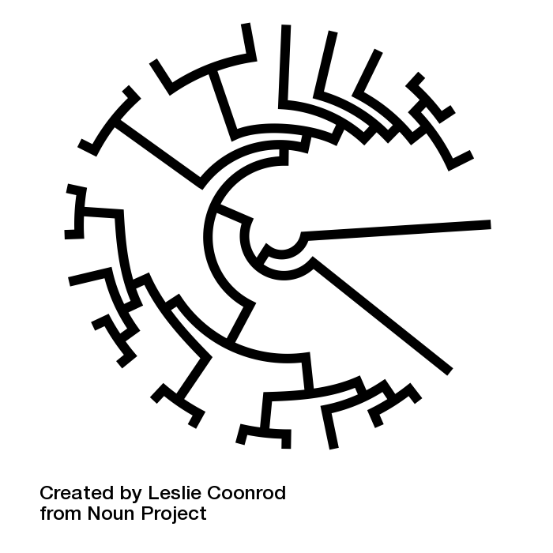
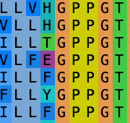
Motivation - Indels
Missing jigsaw in protein engineering puzzle
Evolutionary history of protein families
Insights into the interrelationship between phylogenetic and MSA inference

Slide 3


Problem Statement / Method
Aligned extant sequences
Phylogenetic Tree
n1
Ancestral indel sequence/pattern
n2
e1
Minimise the indel events in the tree (parsimony based approach).
ARHKDE
e2
e3
AR—-DE
AR-K-E
Explain the indel patterns seen in the extant sequences.
Notes:
Parsimony based approach

Slide 4
Desirable Solution Qualities
Simplest explanation of indel events.
Multi-site connection (pattern consistent in ancestors).
Evolutionary Cohesiveness (tree connectedness).
0
1
1 Non-gapped
0 Gap
1
0
0
0
1
1
Avoid reverse consecutive gap patterns (between ancestor and children).
0 1
1 0
1 0
0 1
Global solution (rather than piece wise).
Multiple Optimal solutions.

Slide 5
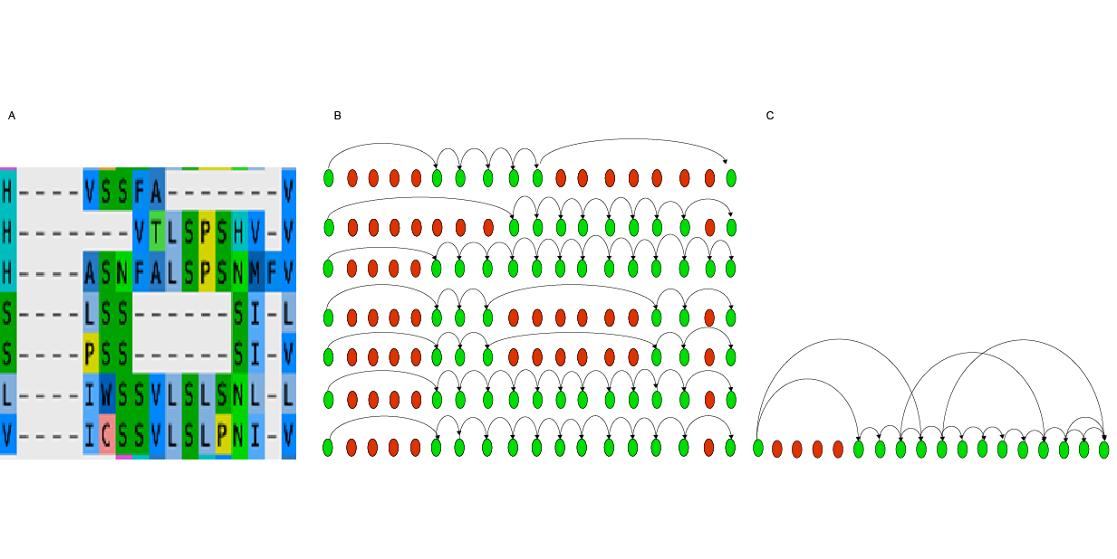
Multi-site connection
A: MSA B: POG C: POAG
MSA : Multiple sequence alignment
POG : Partial order graph
POAG: Partial order alignment graph
Notes:
Edges rationale

Slide 6
Multi-site connection
1 2 3 4 5 6
n1
Ancestors constraints by POAG
1 2 3 4 5 6
n2
e1
ARHKDE
111111
e2
e3
AR—-DE
AR-K-E
110011
110101
Extants represented by POG
1 2 3 4 5 6
1 2 3 4 5 6
1 2 3 4 5 6
Notes:
Parsimony based approach

Slide 7
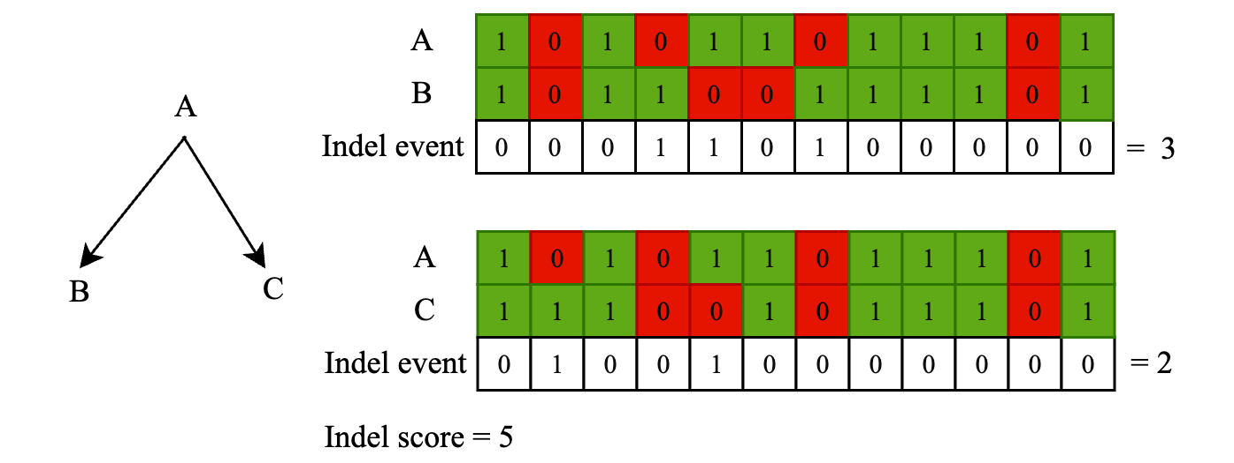
Indel event / score

Slide 8
Optimisation - setup
Positions (a) and Edges (e) binary variables.
Gap opening (g) binary variables.
Site difference (d) binary variables.
Constraints
Tree structure.
Ancestors restricted to POAG.
Every POG in an ancestor is complete path.
Penalise alternate gap opening patterns.

Slide 9
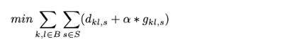
Optimisation - objective
Gap penalty
Hyperparameter
Difference penalty

Slide 10
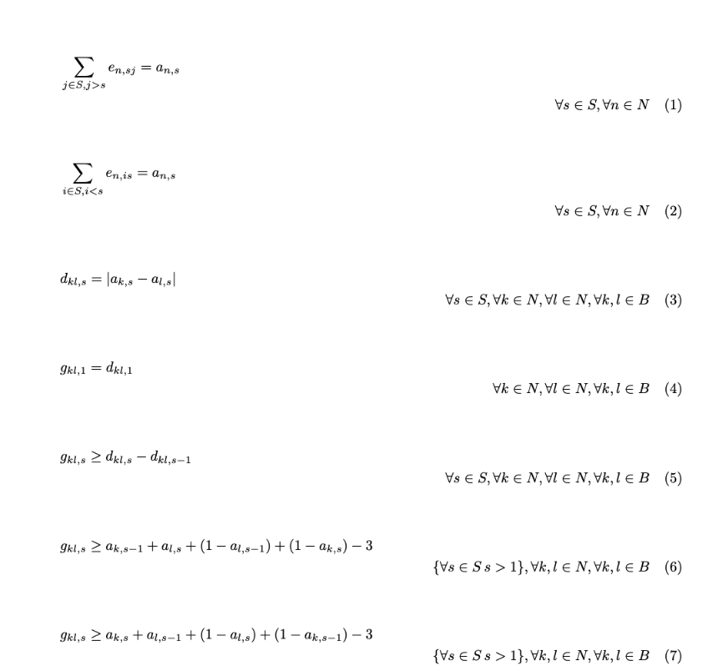
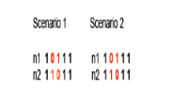
Optimisation - constraints
Position is gap or ungapped is equal to the sum of edges leaving or entering that position.
Difference in indel at a site for each neighbouring node.
Gap penalty for opening gaps.
Penalize alternate gaps.

Slide 11
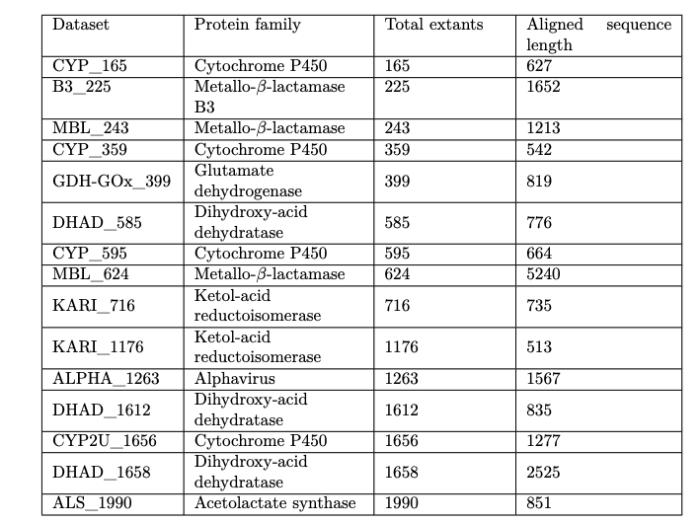
Datasets
15 real datasets.
60 synthetic datasets.
Notes:
Number of sequences mentioned

Slide 12
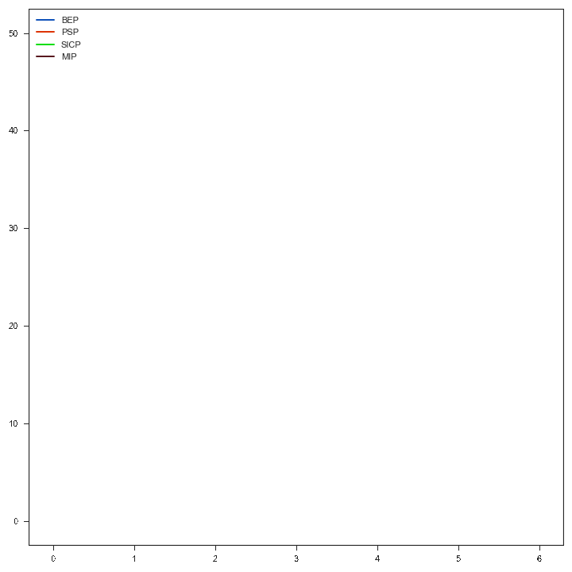
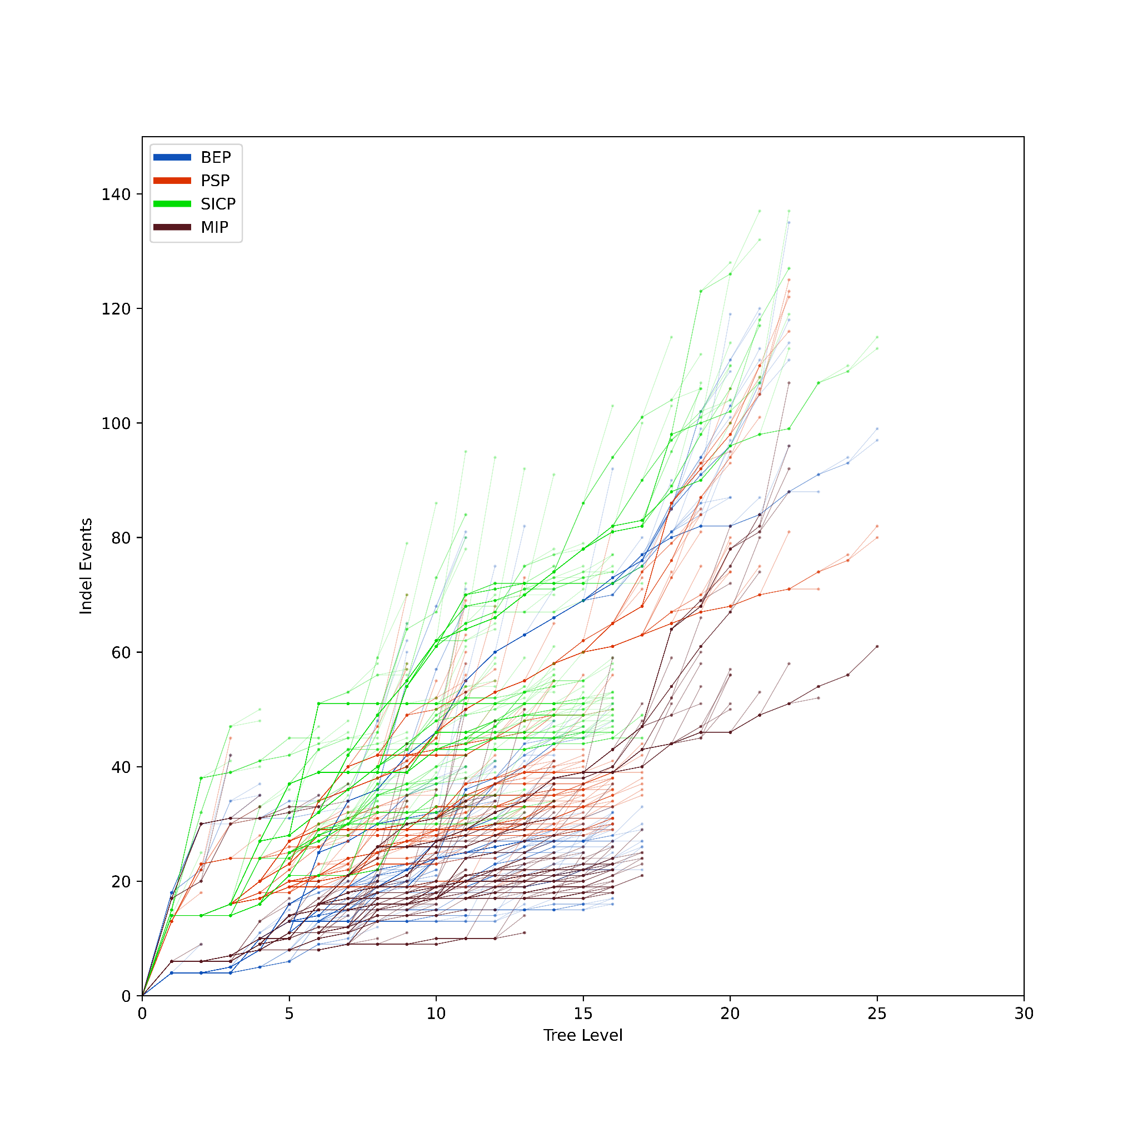
Visualising indel events
RnaseZ_243 dataset

Slide 13
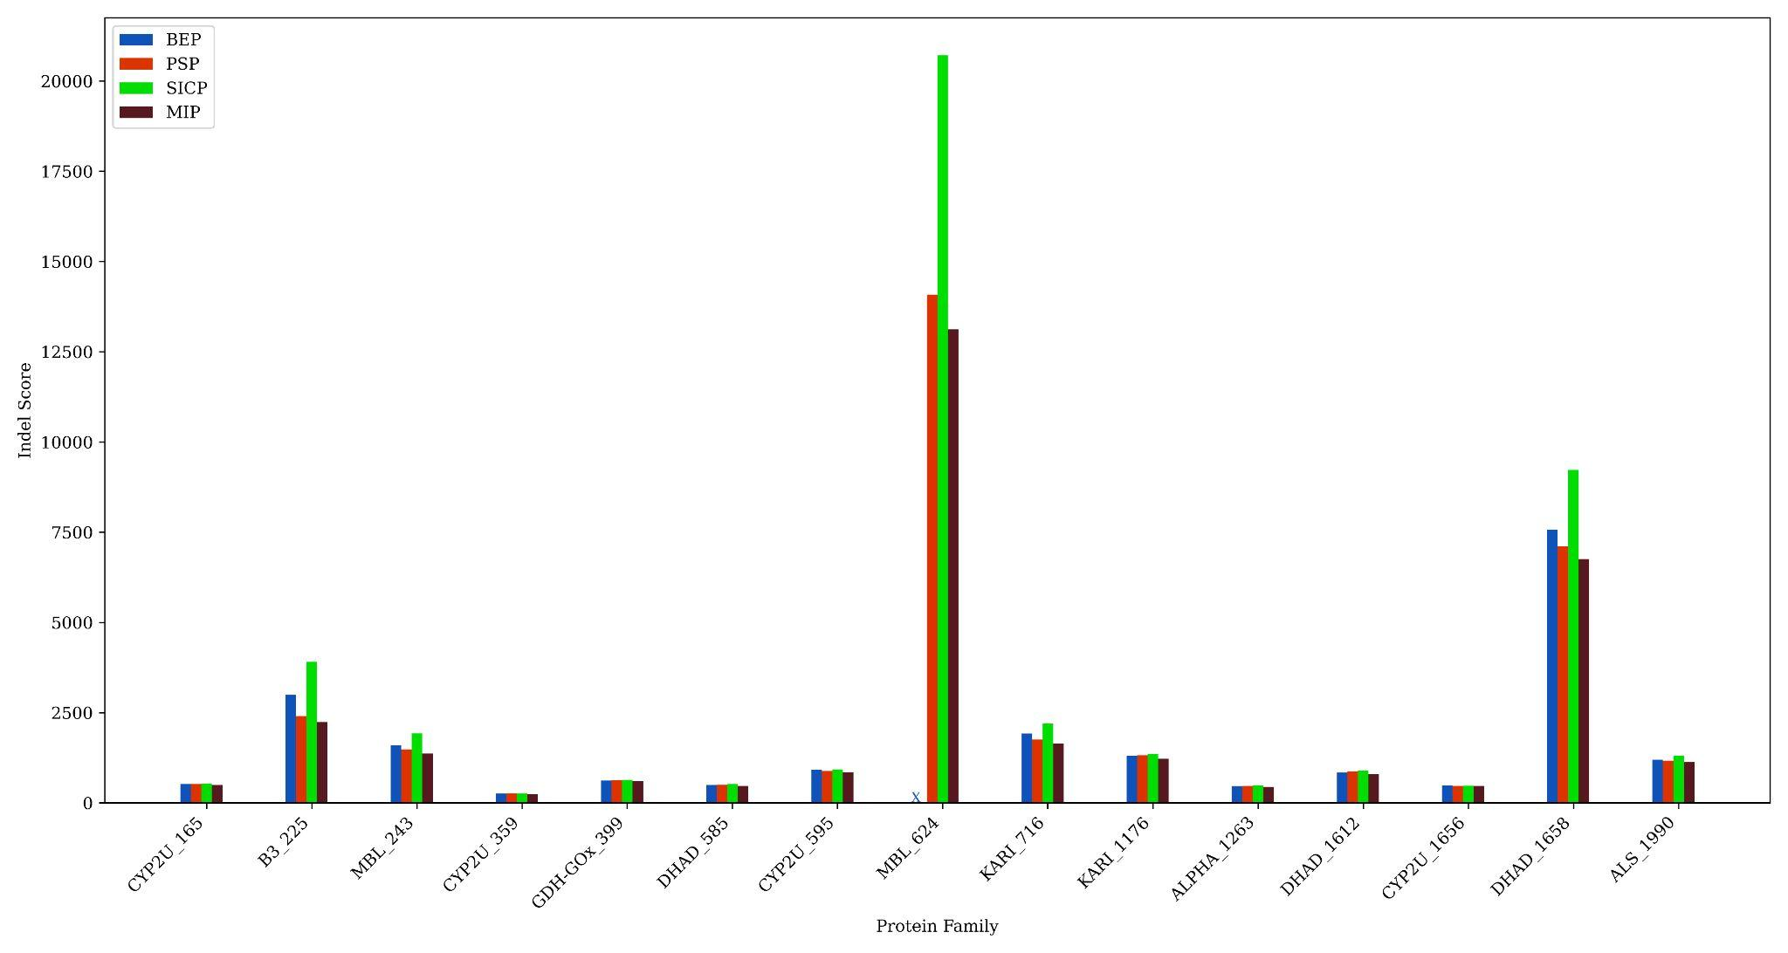
Indel score
Notes:
Different approaches. SICP - fastml, PSP - baseline, BEP - grasp.

Slide 14
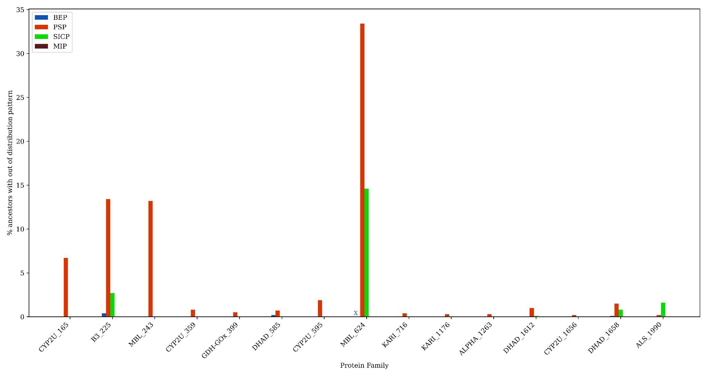
Indel Footprints
Notes:
Out of distribution - why for psp.

Slide 15
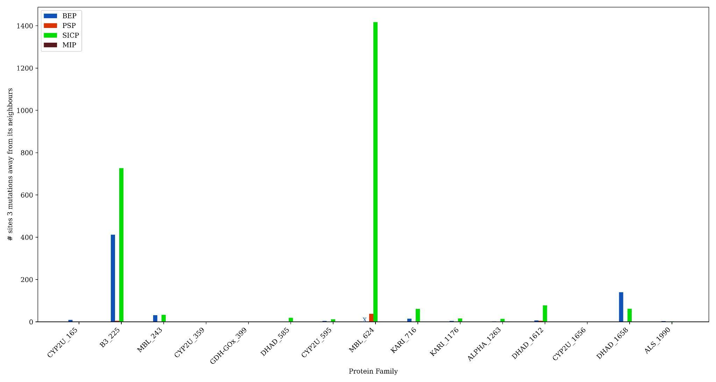
Evolutionary Cohesiveness
1
0
1
1
0
1
0
0
Notes:
Biological meaning talk here.

Slide 16
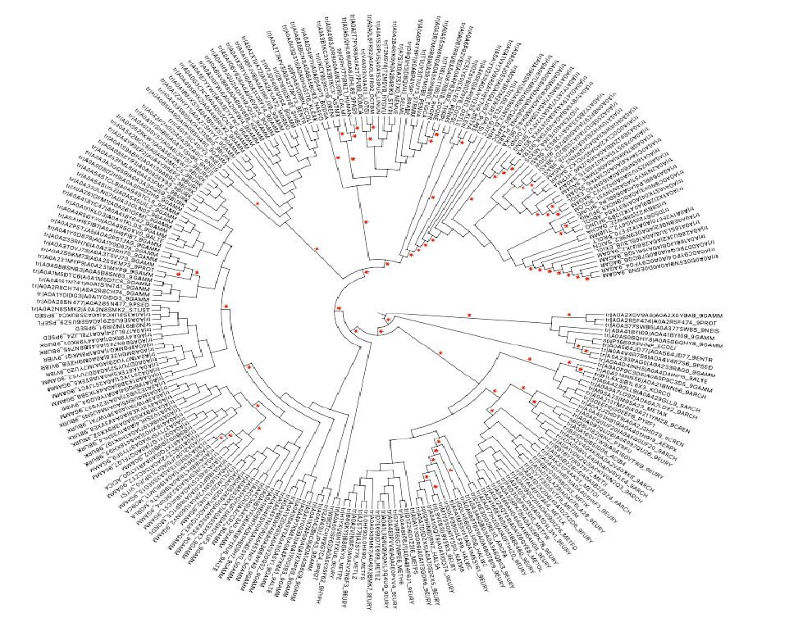
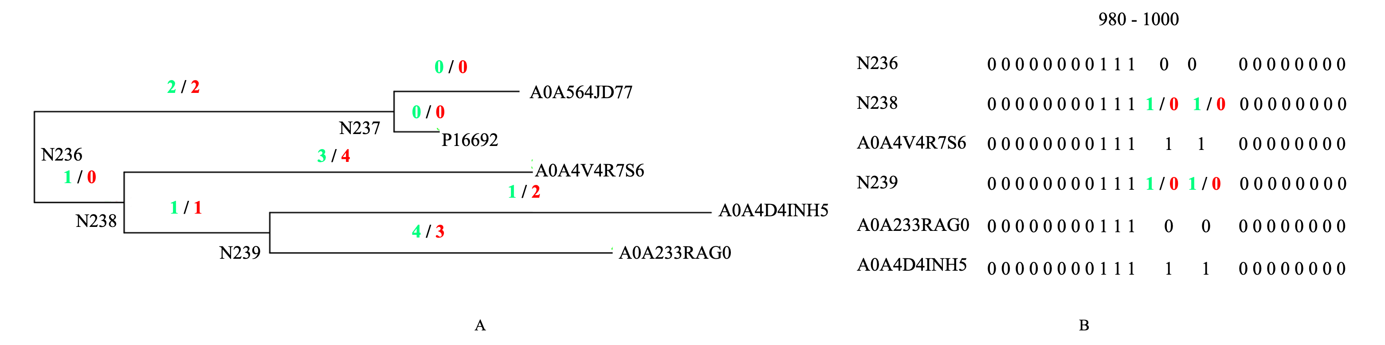
Alternate optimal solution
70 different ancestors.
172 same ancestors.
RnaseZ_243 dataset

Slide 17
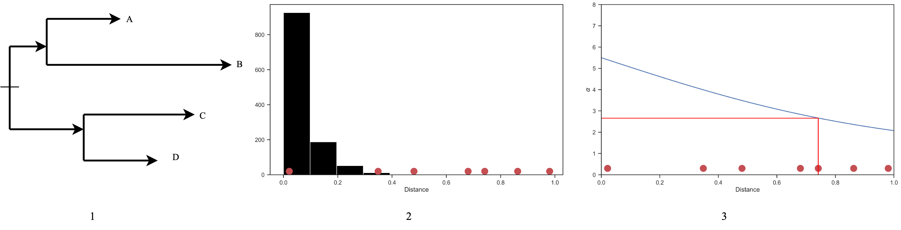
Optimisation – distance informed

Slide 18
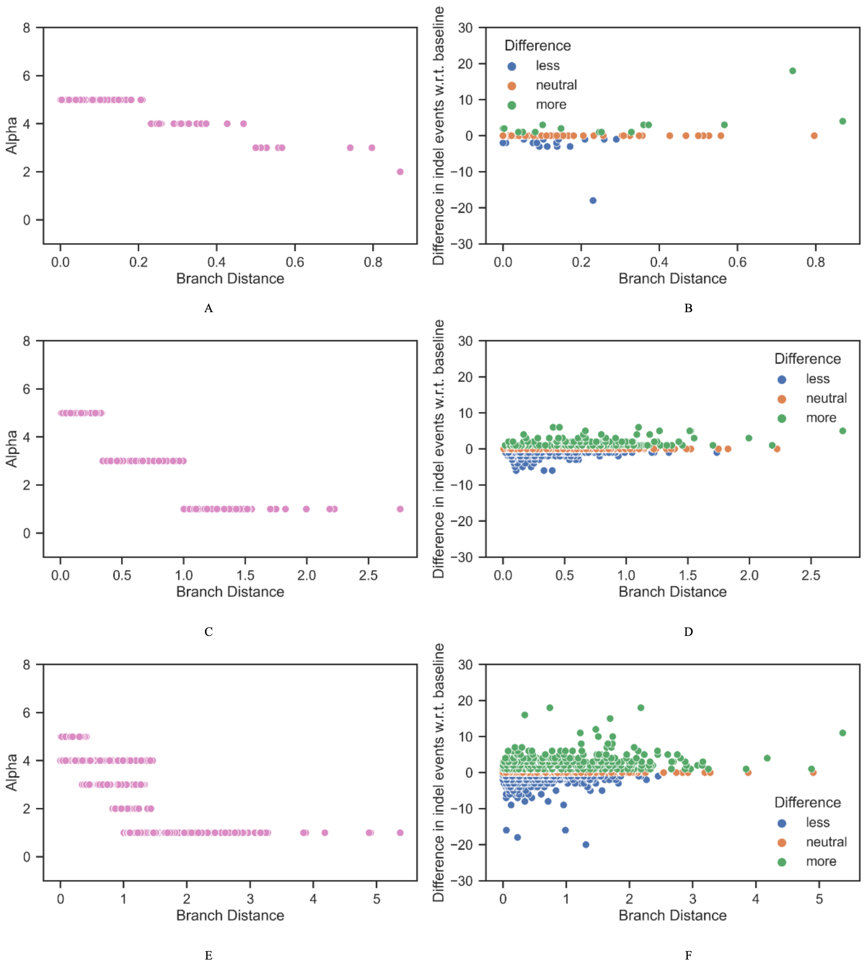
ALPHA_1263
DHAD_1658
All datasets
(real)

Slide 19
Conclusion
Global optimisation formulation for indels. (vertical and horizontal)
Optimality and gap information availability.
Objective can be made branch distance aware.
High correlation between std. deviation in branch distance to difference in indel score (between fixed and variable model).

Slide 20


Thank You
GitHub
Paper
Connect : s.tule@uq.edu.au
LinkedIn : Sanjana Tule

Slide 21
Visualising indel events
RnaseZ_243 dataset

Slide 22
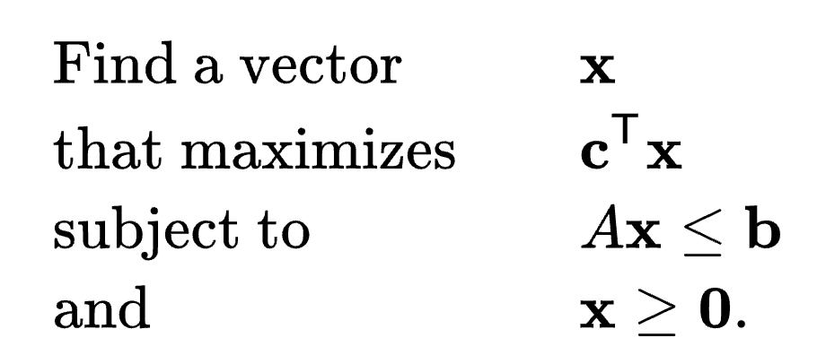
Mixed Integer Programming
determine x
c , b -> vectors
a -> matrix
Problems can be expressed in standard form as follows:

Slide 23
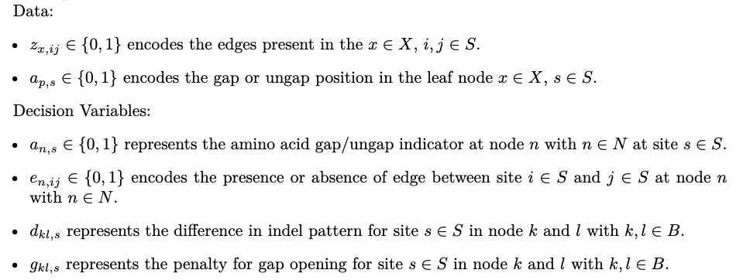
MIP Data & Decision Variables
Leaf node
ancestral node
indel

